Slide 1

data.table
New Developments
Tyson S. Barrett
rfinance(2024L)
Notes:
Image by DALL-E

Slide 2
Who Am I?
Current "maintainer" of data.table (more on this at the end!)
PhD in Quantitative Psychology (Bachelor’s in Economics)
data.table user since 2016, contributor since 2019
Author/maintainer of 6 other R packages (3 on CRAN)
Currently managing a team of researchers at Highmark Health (lots of big data wrangling and cleaning)
CEO of Barrett Evaluation, LLC (big talk for I consult on projects with big data)
rfinance(2024L)

Slide 3
“dplyr will be the death of data.table ”
An attendee said to Matt Dowle (creator of data.table) at an R Finance Conference a decade ago
library(tidyverse)
df %>%
filter(x == 1) %>%
mutate(z = y * 2)
library(data.table)
dt[x == 1][, z := y * 2]
rfinance(2024L)
Notes:
No arguing that the tidyverse changed the way R (and several other languages) think about syntax and data
But it isn’t the tool for everything all the time
I’ll use examples from the tidyverse so we have a shared language here

Slide 4

Agenda
Why use data.table ?
New developments!
New “management”
New features
New ways to engage
rfinance(2024L)

Slide 5
data.table
Why
?
Concise syntax
Fast speed
Memory efficient
Careful API lifecycle management
Community
Feature rich
Matt’s useR talk from 2014 https://youtu.be/qLrdYhizEMg?t=1m54s
rfinance(2024L)
Notes:
Why data.table? Here’s a few as listed on the data.table README file.

Slide 6
data.table
Why
?
Concise syntax
Fast speed
Memory efficient
Careful API lifecycle management
Community
Feature rich
rfinance(2024L)
Notes:
Here, we’ll just focus on the first three.

Slide 7
data.table
Why
?
Concise syntax
Fast speed
dt[i, j, by]
Memory efficient
Careful API lifecycle management
“WHERE”
or
“ORDER BY”
Community
“GROUP BY”
or
“PARTITION BY”
“SELECT”
Feature rich
rfinance(2024L)
Notes:
First is the syntax. The main aspects of the code can be presented right here: dt is a data.table and in the square brackets go i, j, and by.
You can think of i as being code that you would put in filter
j is nearly identical code as you’d put in mutate
by is essentially identical to what you would put in group_by
Very R centric thinking

Slide 8
data.table
Why
?
Concise syntax
Fast speed
Memory efficient
dt[grp == “treatment”, new := mean(x), by = id]
dt[dt2, on = “id”]
dt[dt2, on = “id”, roll = TRUE] # rolling joins!
dt[, .N, by = id]
rfinance(2024L)
Notes:
First is the syntax. The main aspects of the code can be presented right here: dt is a data.table and in the square brackets go i, j, and by.
You can think of i as being code that you would put in filter
j is nearly identical code as you’d put in mutate
by is essentially identical to what you would put in group_by
Very R centric thinking

Slide 9
data.table
Why
?
Concise syntax
Responding to why data.table is so fast, Hadley Wickham:
Fast speed
Memory efficient
“I think it’s a relentless focus on performance across the entire package.”
Careful API lifecycle management
Community
Feature rich
https://twitter.com/hadleywickham/status/1153850194892640256
Before the death of Twitter
rfinance(2024L)
Notes:
Next: data.table is incredibly fast. And the speed improvements from other approaches gets more and more meaningful as your data get really big and you have lots of groups. Hadley said this.
In my experience working with the data table team, they are incredibly focused on performance, even for little adjustments.

Slide 10
data.table
Why
?
Concise syntax
https://duckdblabs.github.io/db-benchmark/
Fast speed
It’s consistently one of the top performing, even with major investments in tools like DuckDB and Polars
Memory efficient
Careful API lifecycle management
Community
Feature rich
rfinance(2024L)
Notes:
Finally it is super memory efficient. Data sets that shut down other systems work in data.table. This table shows how different systems handled a data set with 1 billion rows and 9 columns.

Slide 11
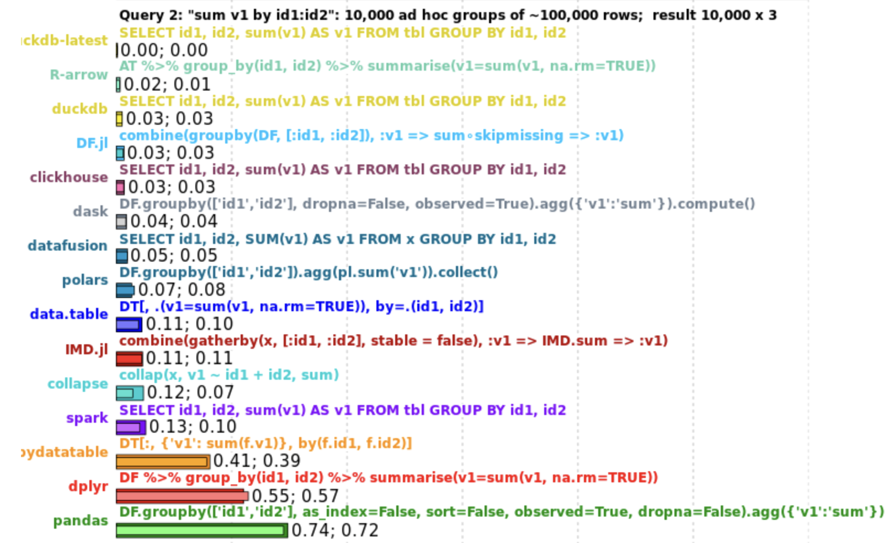
data.table
Why
?
Concise syntax
https://duckdblabs.github.io/db-benchmark/
Fast speed
It’s consistently one of the top performing, even with major investments in tools like DuckDB and Polars
data.table has more features
Memory efficient
Careful API lifecycle management
Community
Feature rich
rfinance(2024L)
Notes:
Finally it is super memory efficient. Data sets that shut down other systems work in data.table. This table shows how different systems handled a data set with 1 billion rows and 9 columns.

Slide 12
data.table
Why
?
Concise syntax
https://duckdblabs.github.io/db-benchmark/
Fast speed
It’s consistently one of the top performing, even with major investments in tools like DuckDB and Polars
data.table has more features than many of these: it can interact with data since you still have all of the tools in R to work with
Memory efficient
data.table has more features than many of these
(it can interact with data with all of the tools in R, including custom functions)
Careful API lifecycle management
Community
Feature rich
rfinance(2024L)
Notes:
Finally it is super memory efficient. Data sets that shut down other systems work in data.table. This table shows how different systems handled a data set with 1 billion rows and 9 columns.

Slide 13
data.table
Why
?
Concise syntax
Fast speed
Thoughtful and careful so there are very few breaking changes
Can be used in production code safely
Memory efficient
Careful API lifecycle management
Community
Feature rich
Matt’s useR talk from 2014 https://youtu.be/qLrdYhizEMg?t=1m54s
rfinance(2024L)
Notes:
This may be one of the key reasons people use it in production compared to other tools

Slide 14
New Developments!
Grant from NSF (PI = Toby Hocking) to create new governance and support its development (NSF POSE program, project #2303612)
Re-invigorated development and new features
Ways to engage in development
rfinance(2024L)

Slide 15
New Developments!
Grant from NSF (PI = Toby Hocking) to create new governance and support its development (NSF POSE program, project #2303612)
https://github.com/Rdatatable/data.table/blob/master/GOVERNANCE.md
rfinance(2024L)

Slide 16
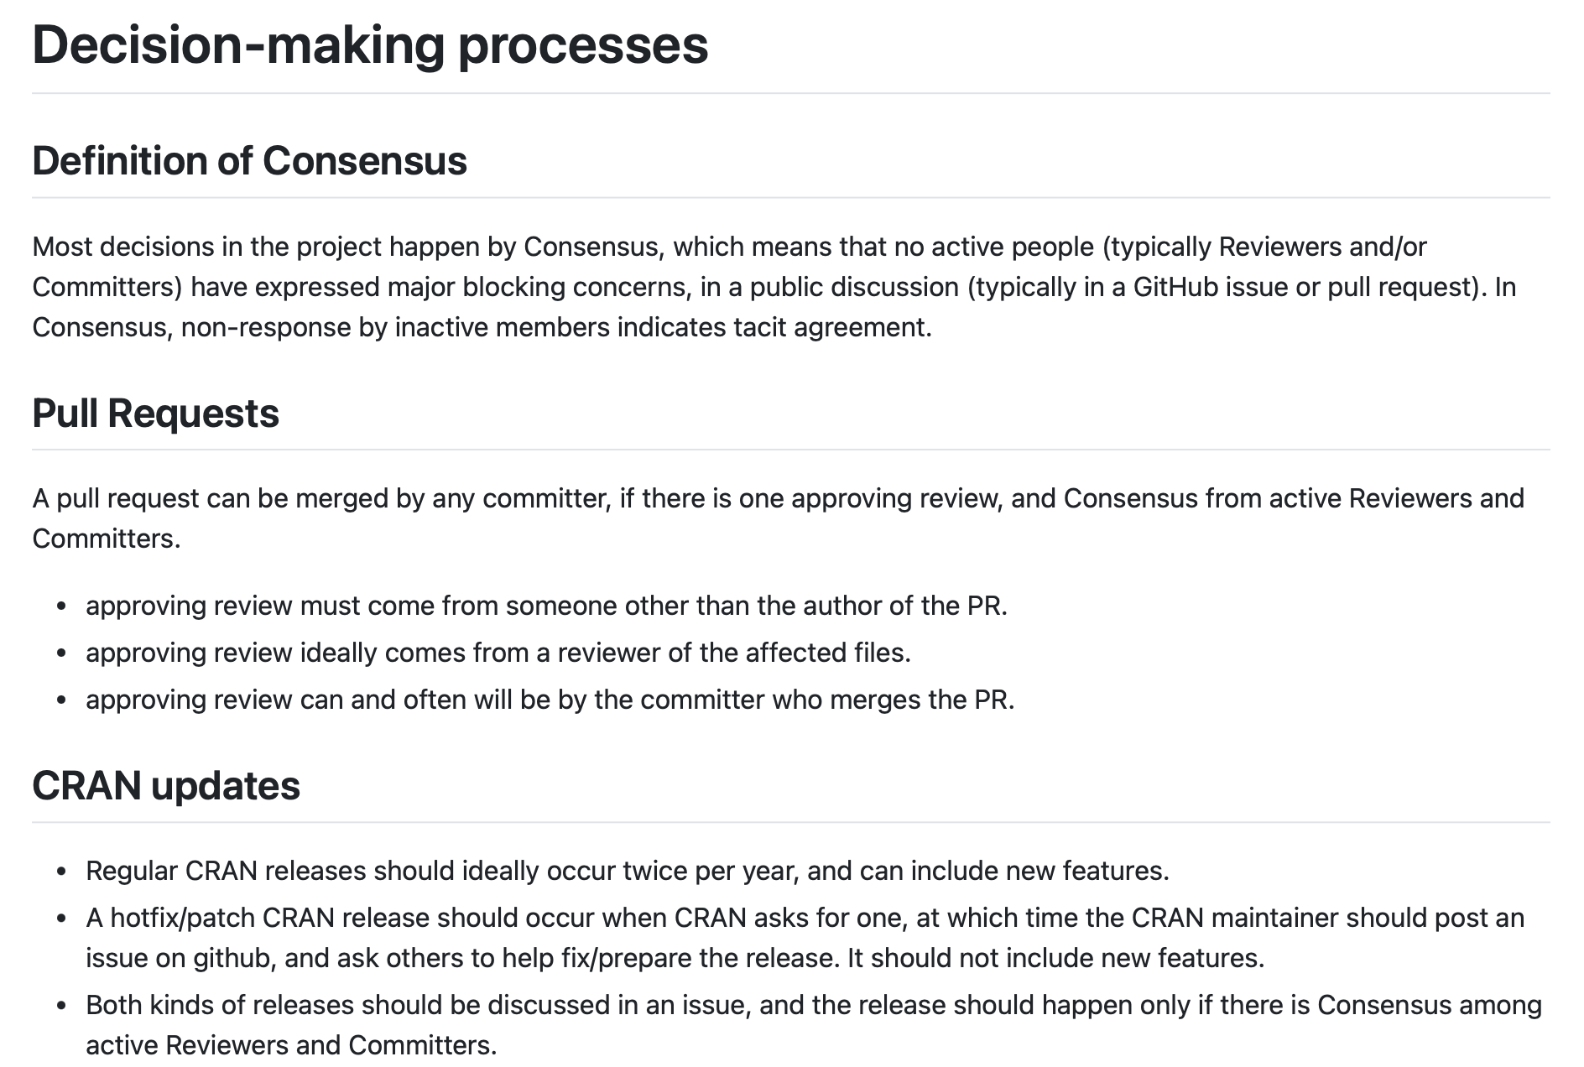
New Developments!
Grant from NSF (PI = Toby Hocking) to create new governance and support its development (NSF POSE program, project #2303612)
https://github.com/Rdatatable/data.table/blob/master/GOVERNANCE.md
rfinance(2024L)

Slide 17
New Developments!
A semi-democratic approach to dev
Can become any role in data.table by submitting PR and enough votes from the community
Can help shape the development of the package
One aspect of the governance is the “what is possible for development” which can be updated
Grant from NSF (PI = Toby Hocking) to create new governance and support its development (NSF POSE program, project #2303612)
https://github.com/Rdatatable/data.table/blob/master/GOVERNANCE.md
rfinance(2024L)

Slide 18
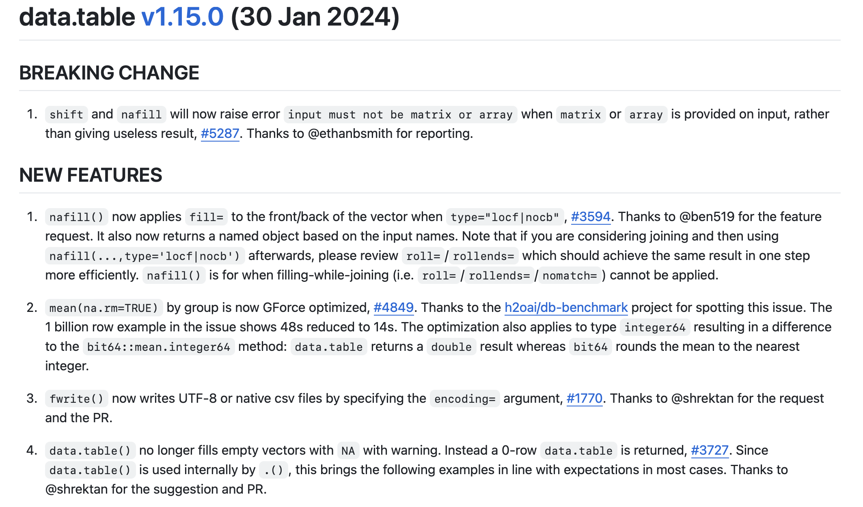
New Developments!
Re-invigorated development and new features
41 new features!
And several fixes and speed ups
rfinance(2024L)

Slide 19
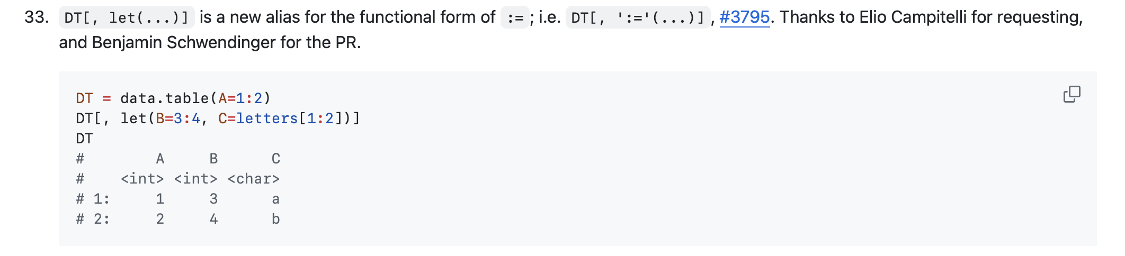
New Developments!
Re-invigorated development and new features
rfinance(2024L)
Notes:
Some of my favorite new features

Slide 20
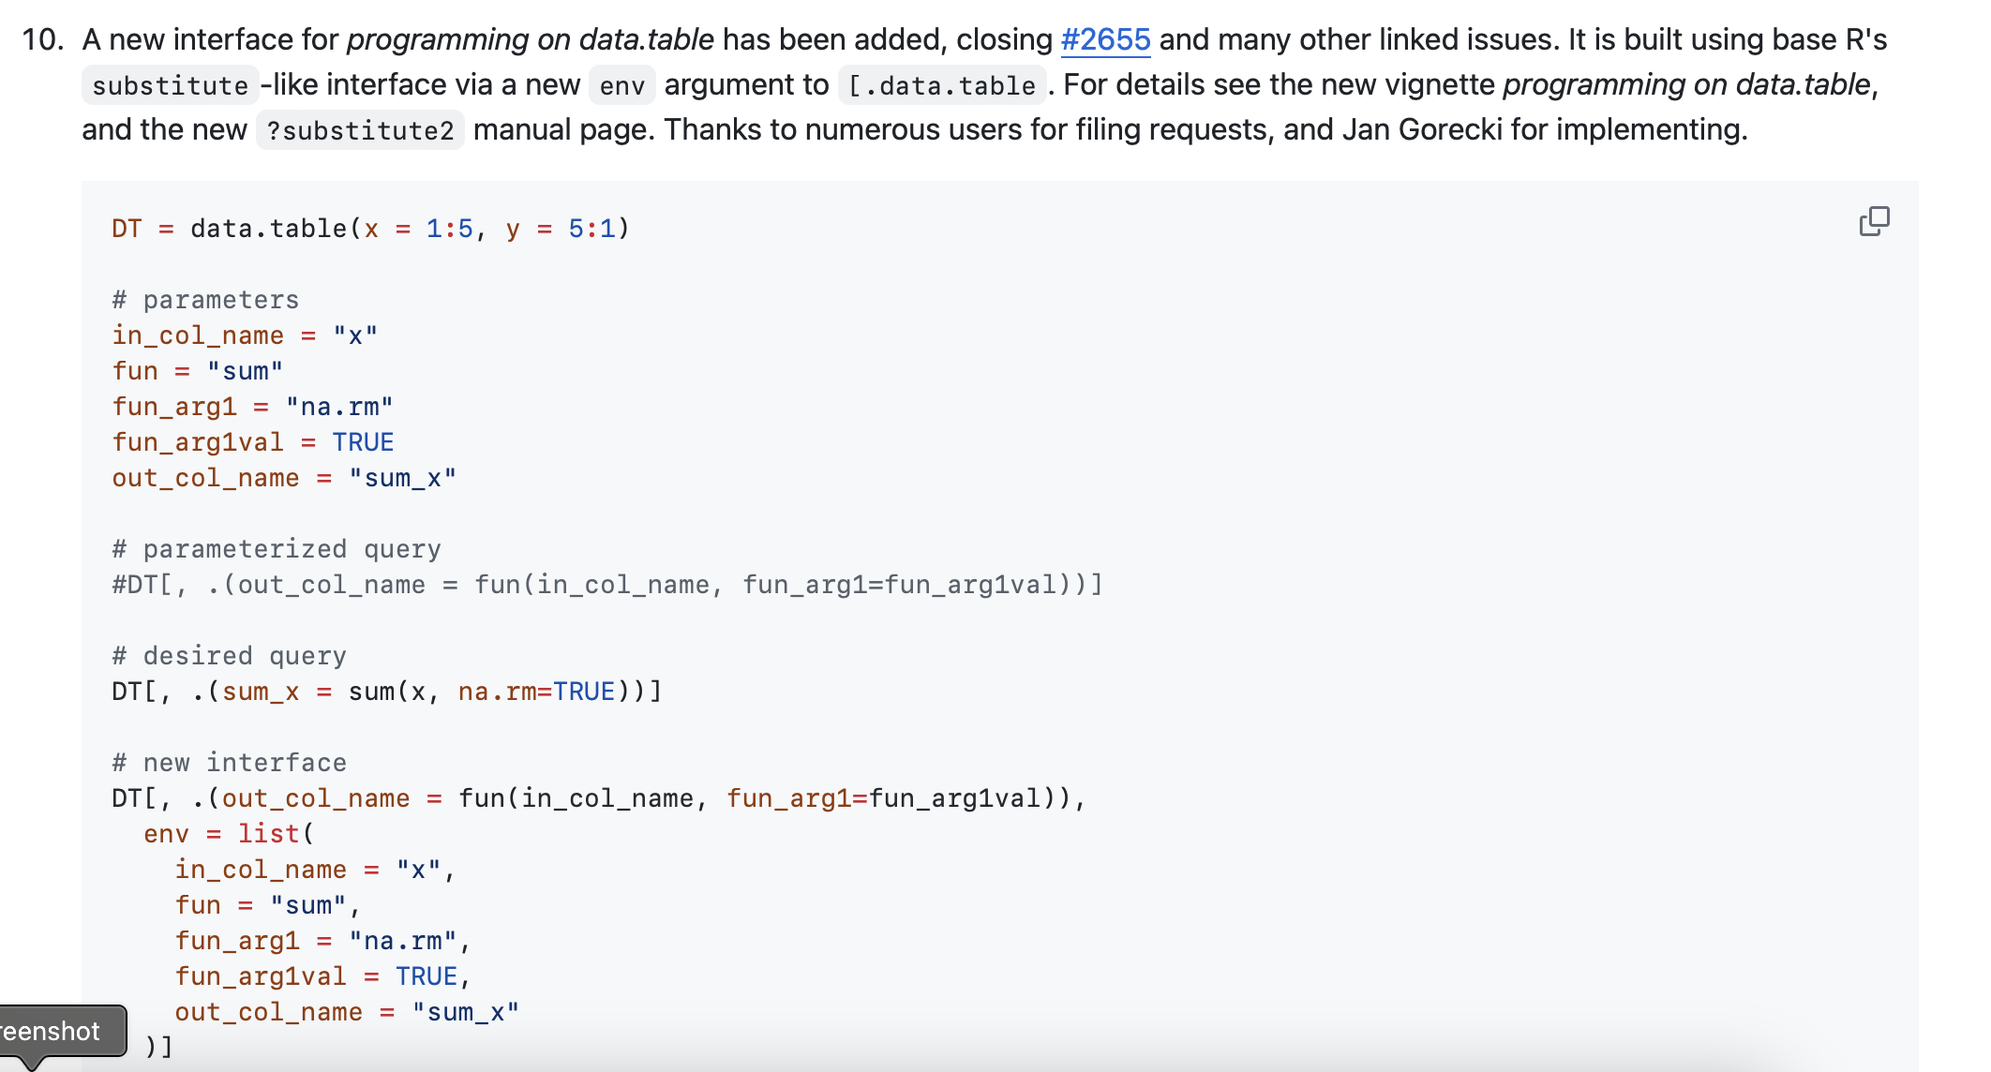
New Developments!
Re-invigorated development and new features
rfinance(2024L)
Notes:
Some of my favorite new features

Slide 21
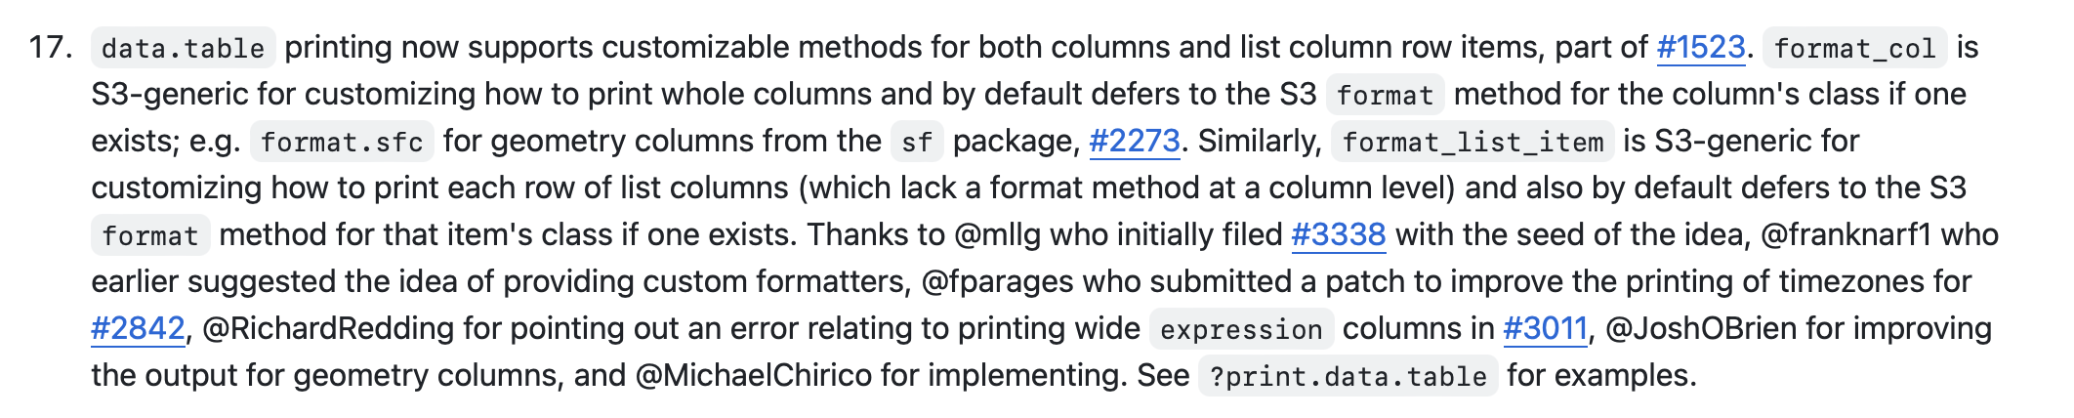
New Developments!
Re-invigorated development and new features
rfinance(2024L)
Notes:
Some of my favorite new features

Slide 22
New Developments!
Ways to engage in development
1
GitHub Issue Tracker
rfinance(2024L)

Slide 23
New Developments!
Ways to engage in development
2
“Seal of Approval”
https://github.com/Rdatatable/data.table/issues/5723
rfinance(2024L)

Slide 24
New Developments!
Ways to engage in development
3
Vote on GitHub Pull Requests
rfinance(2024L)

Slide 25
New Developments!
Ways to engage in development
4
Talk, publish about it
rfinance(2024L)
Notes:
Writing blogs and examples of how you use it helps build a community

Slide 26





Tyson S. Barrett
Thanks to Matt Dowle and Arun Srinivasan and the data.table team!
t.barrett88@gmail.com
tysonbarrett.com
@healthandstats
github.com/tysonstanley
Slides at tysonbarrett.com/teaching
rfinance(2024L)
Notes:
I hope it is clear that data.table can be a valuable tool to use in conjunction with the tidyverse.
I recommend, if you are comfortable with dplyr code, to use the dtplyr package to learn data.table code (among many other fantastic resources)
data.table and the tidyverse are not rivals, but rather are complimentary

